Slide 1
Object-oriented Programming

Slide 2
Agenda
Introduction to OOP
Creating Classes and Objects
Four Principles of OOP
Practical Exercise
Inheritance and Polymorphism
Practical Exercise
Cheat Sheet

Slide 3
Learning Outcomes
Understand the concepts of objects, classes, and OOP principles
Learn the fundamentals of OOP and its terminology
Learn how to create classes and define methods in Python
Gain practical skills in implementing OOP in Python
Apply OOP concepts using a real-world dataset
Reinforce learning through hands-on practice
Understand inheritance and polymorphism

Slide 4
Object-oriented Programming
What is it?
OOP Programming paradigm based on objects and classes
Objects and Classes Objects: Instances of classes with attributes and methods Classes: Blueprints or templates for creating objects
Advantages of OOP in data engineering Modularity, reusability, and maintainability of code

Slide 5
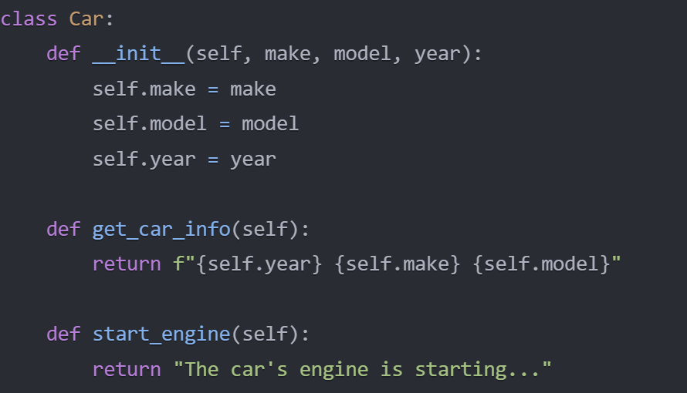
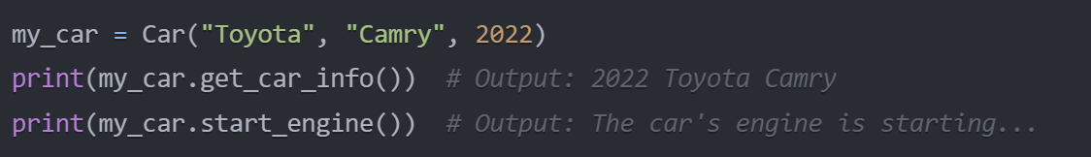
Creating Classes and Objects in Python
class:
a class describes the contents of the objects that belong to it: it describes an aggregate of data fields (called instance variables) and defines the operations (called methods).
object:
an object is an element (or instance) of a class; objects have the behaviours of their class. The object is the actual component of programs, while the class specifies how instances are created and how they behave.
method:
a method is an action which an object is able to perform.

Slide 6
Four principles of OOP
Encapsulation
Abstraction
Inheritance
Polymorphism

Slide 7
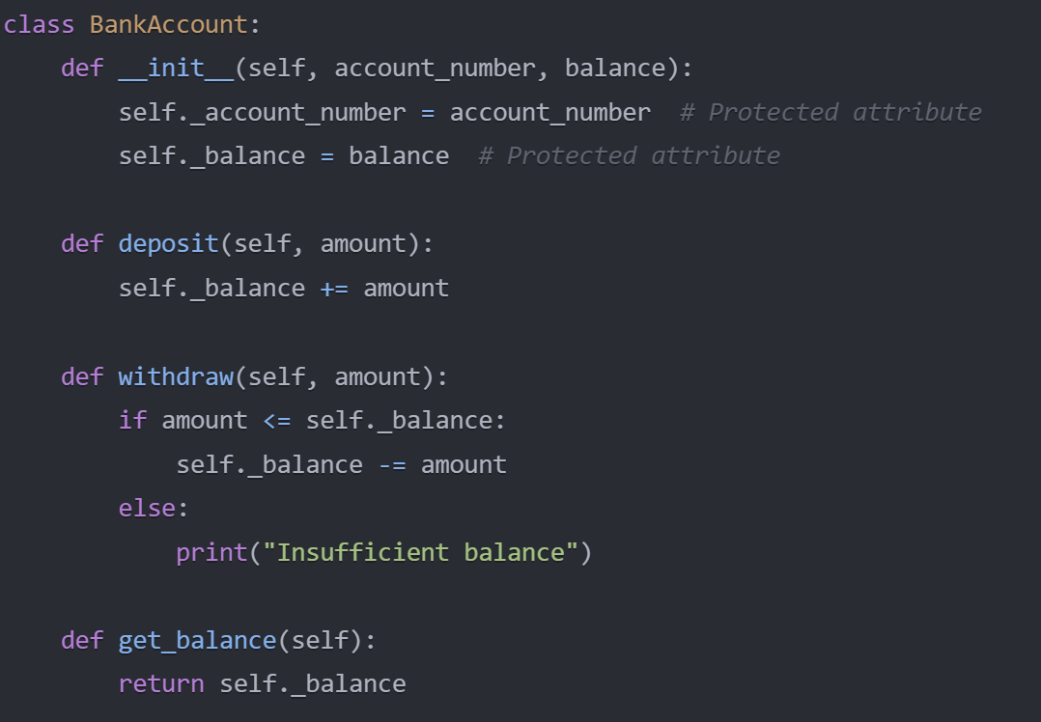
Encapsulation
Bundling data and methods within a class
Hiding internal details and providing a public interface

Slide 8
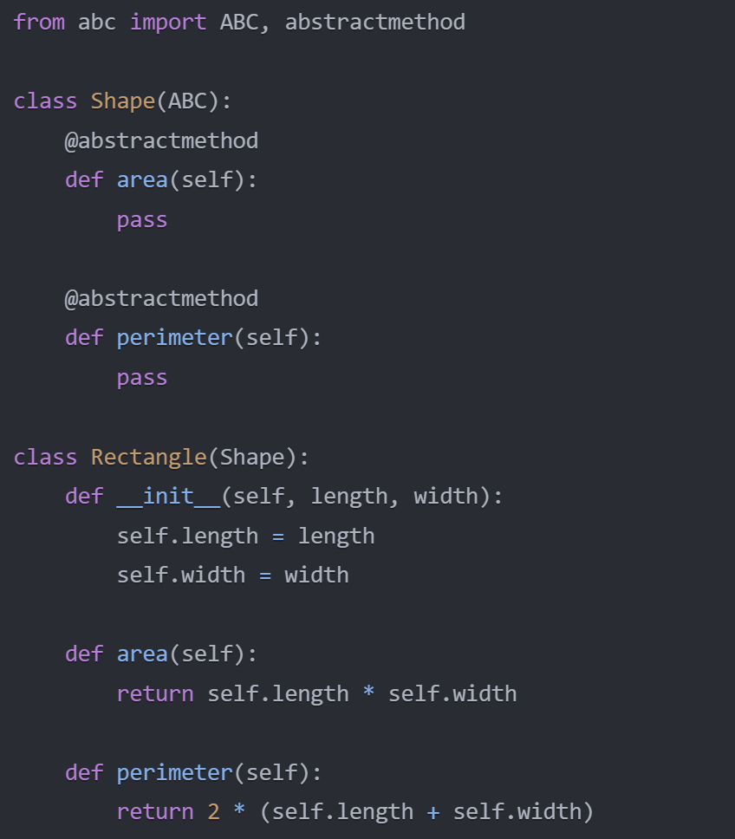
Abstraction
Focusing on essential features and hiding unnecessary details
Creating abstract classes and interfaces

Slide 9
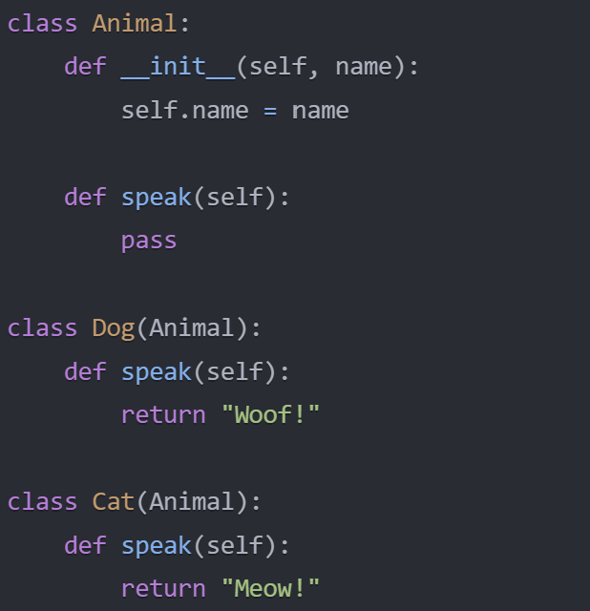
Inheritance
Creating specialized classes based on existing classes
Promoting code reuse and hierarchical structure

Slide 10
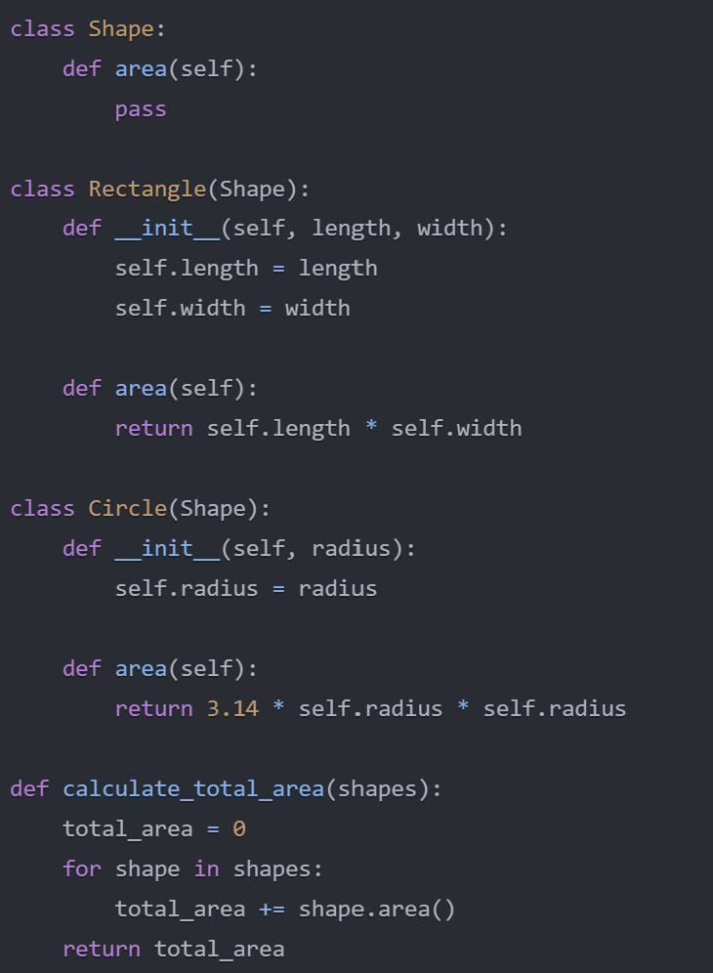
Polymorphism
Objects with multiple forms or behaviours
Treating objects of different classes interchangeably

Slide 11
Practical Exercise: Creating a class and method - 40 Mins
Exercise instructions:
Create a class called Customer with the following attributes: email: The customer's email address total_spent: The total amount spent by the customer membership_length: The length of the customer's membership in years
Define an __init__ method in the Customer class that takes email, total_spent, and membership_length as parameters and initializes the corresponding attributes.
Create a method called get_customer_info in the Customer class that returns a string with the customer's email and total amount spent. STRETCH
Add a method called get_membership_level in the Customer class that determines the customer's membership level based on the membership_length attribute.
Modify the get_customer_info method to include the membership level in the returned string.
Instantiate instances of the Customer class with sample data and call the get_customer_info method to print their information.

Slide 12
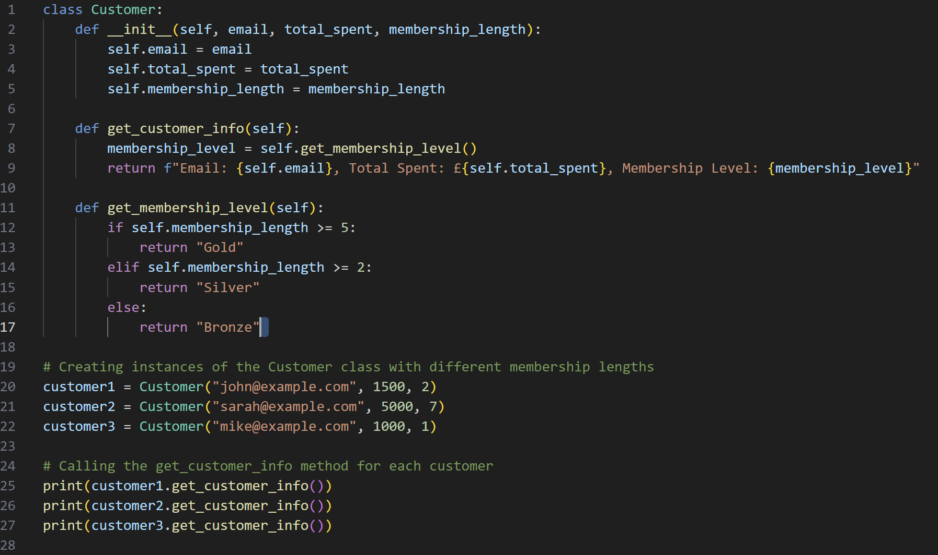
Solution

Slide 13
Inheritance and Polymorphism
Inheritance
Creating specialized classes based on existing classes
Inheriting attributes and methods from the parent class
Polymorphism
Objects with multiple forms or behaviours
Overriding methods in subclasses for specific behaviours

Slide 14
Inheritance and Polymorphism Practical Exercise – 40 mins
Create a subclass called PreferredCustomer that inherits from the Customer class.
Add an attribute called preferred_status to the PreferredCustomer class and set it to True.
Override the get_customer_info method in the PreferredCustomer class. Call the get_customer_info method from the parent Customer class using Customer.get_customer_info(self) and store the result in a variable called info. Append the preferred_status to the info string and return the updated string.
Add a method called get_preferred_gift in the PreferredCustomer class that returns a string representing a gift for preferred customers (e.g., "Free shipping coupon").
Create another subclass called VIPCustomer that inherits from the Customer class.
Add an attribute called vip_status to the VIPCustomer class and set it to True.
Override the get_customer_info method in the VIPCustomer class. Call the get_customer_info method from the parent Customer class using Customer.get_customer_info(self) and store the result in a variable called info. Append the vip_status to the info string and return the updated string.
Add a method called get_vip_gift in the VIPCustomer class that returns a string representing a gift for VIP customers (e.g., "Exclusive VIP gift").
Load the "Ecommerce Customers.csv" dataset using pandas and create instances of different customer types (Customer, PreferredCustomer, and VIPCustomer) based on the following conditions:
If the total amount spent is greater than 5000, create a VIPCustomer instance.
If the membership length is greater than 2, create a PreferredCustomer instance.
Otherwise, create a regular Customer instance.
(Stretch Goal) Use polymorphism to call the get_customer_info method for each customer in the customers list, which will display the appropriate information based on the customer type.
(Stretch Goal) Use polymorphism to determine and print the gift for each customer based on their customer type.
If the customer is a PreferredCustomer, call the get_preferred_gift method and print the result. Also, print the customer's email and membership level.
If the customer is a VIPCustomer, call the get_vip_gift method and print the result. Also, print the customer's email and membership level.
If the customer is a regular Customer, print a message indicating that no special gift is available. Also, print the customer's email and membership level.

Slide 15
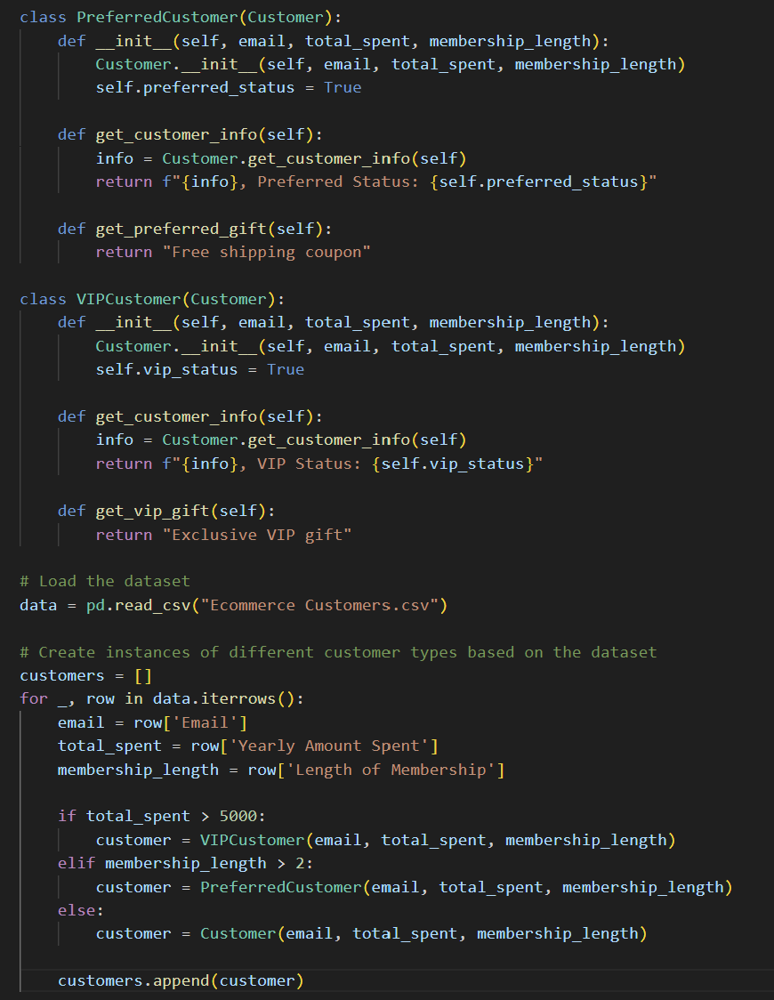
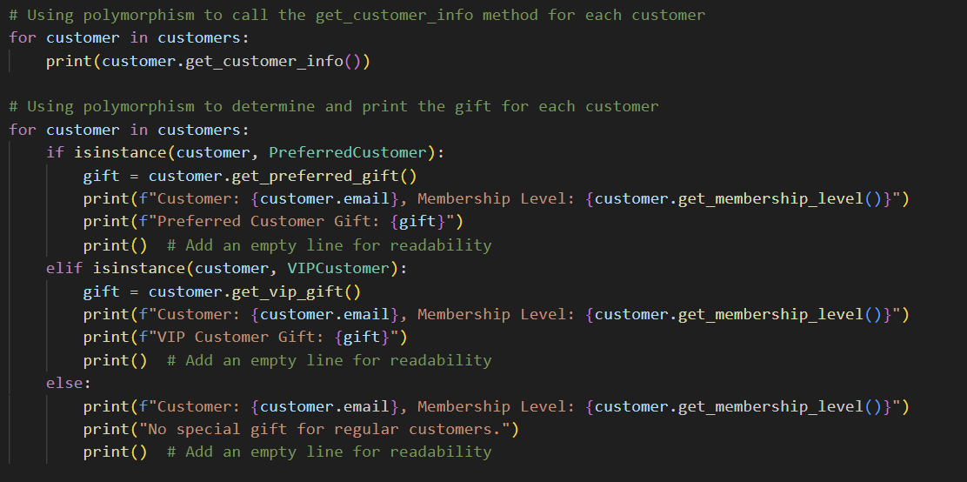
Solution

Slide 16
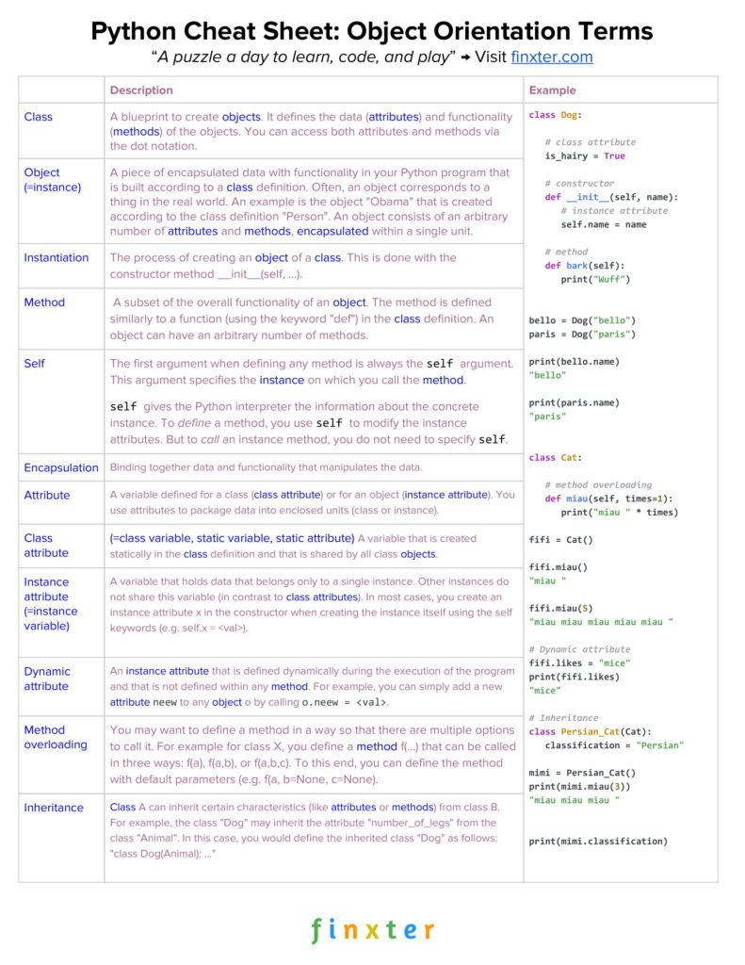
OOP CHEAT SHEET

Slide 17
THANK YOU

